Slide 1

The Threat of MEV Centralization: An Anatomy of the Transaction Supply Chain

Slide 2
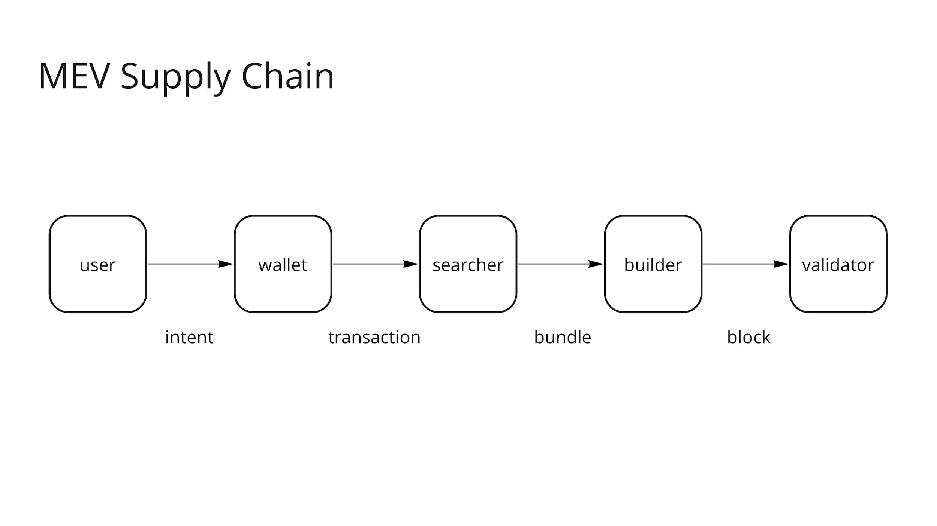

Slide 3
User guarantees today
Competition between miners/validators →
users get their transactions mined at the cheapest possible price, which is the cost of the production (e.g., increased uncle rate)
Censorship resistance

Slide 4
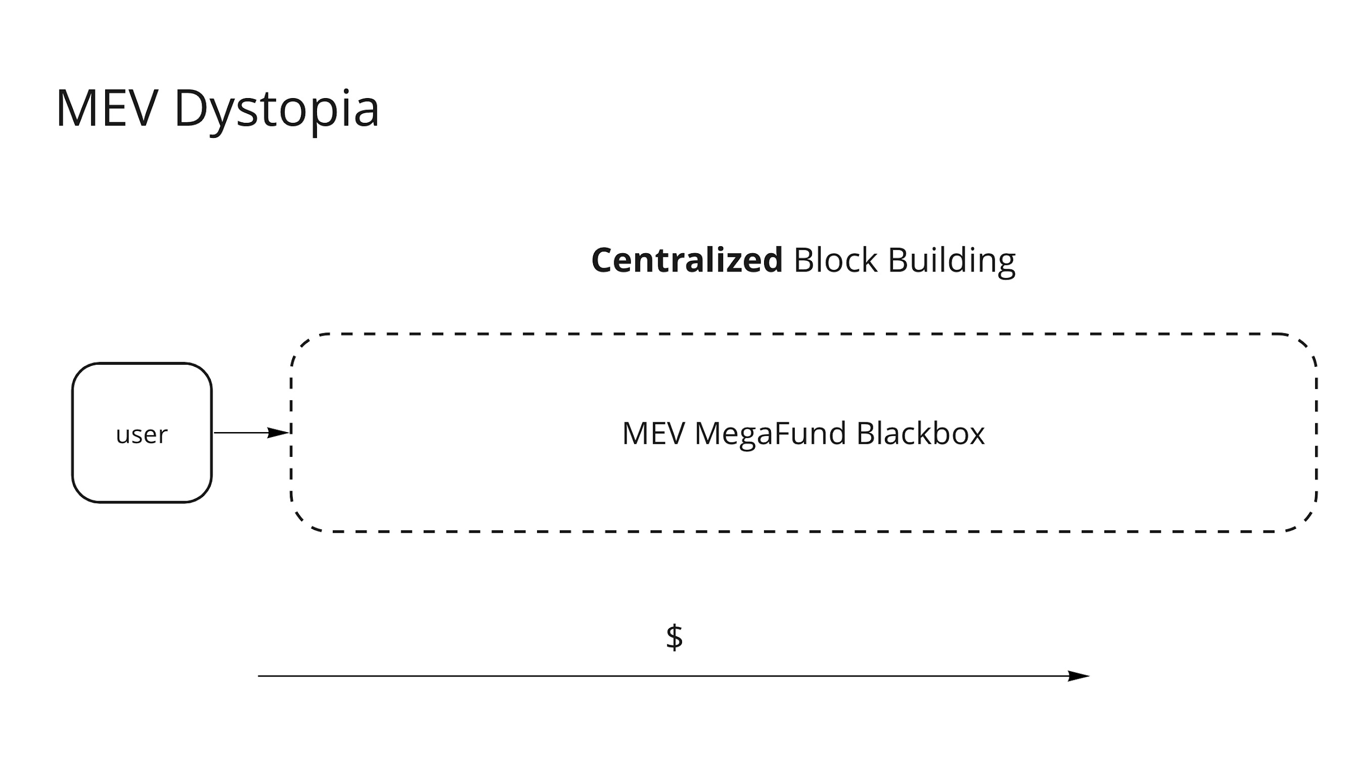
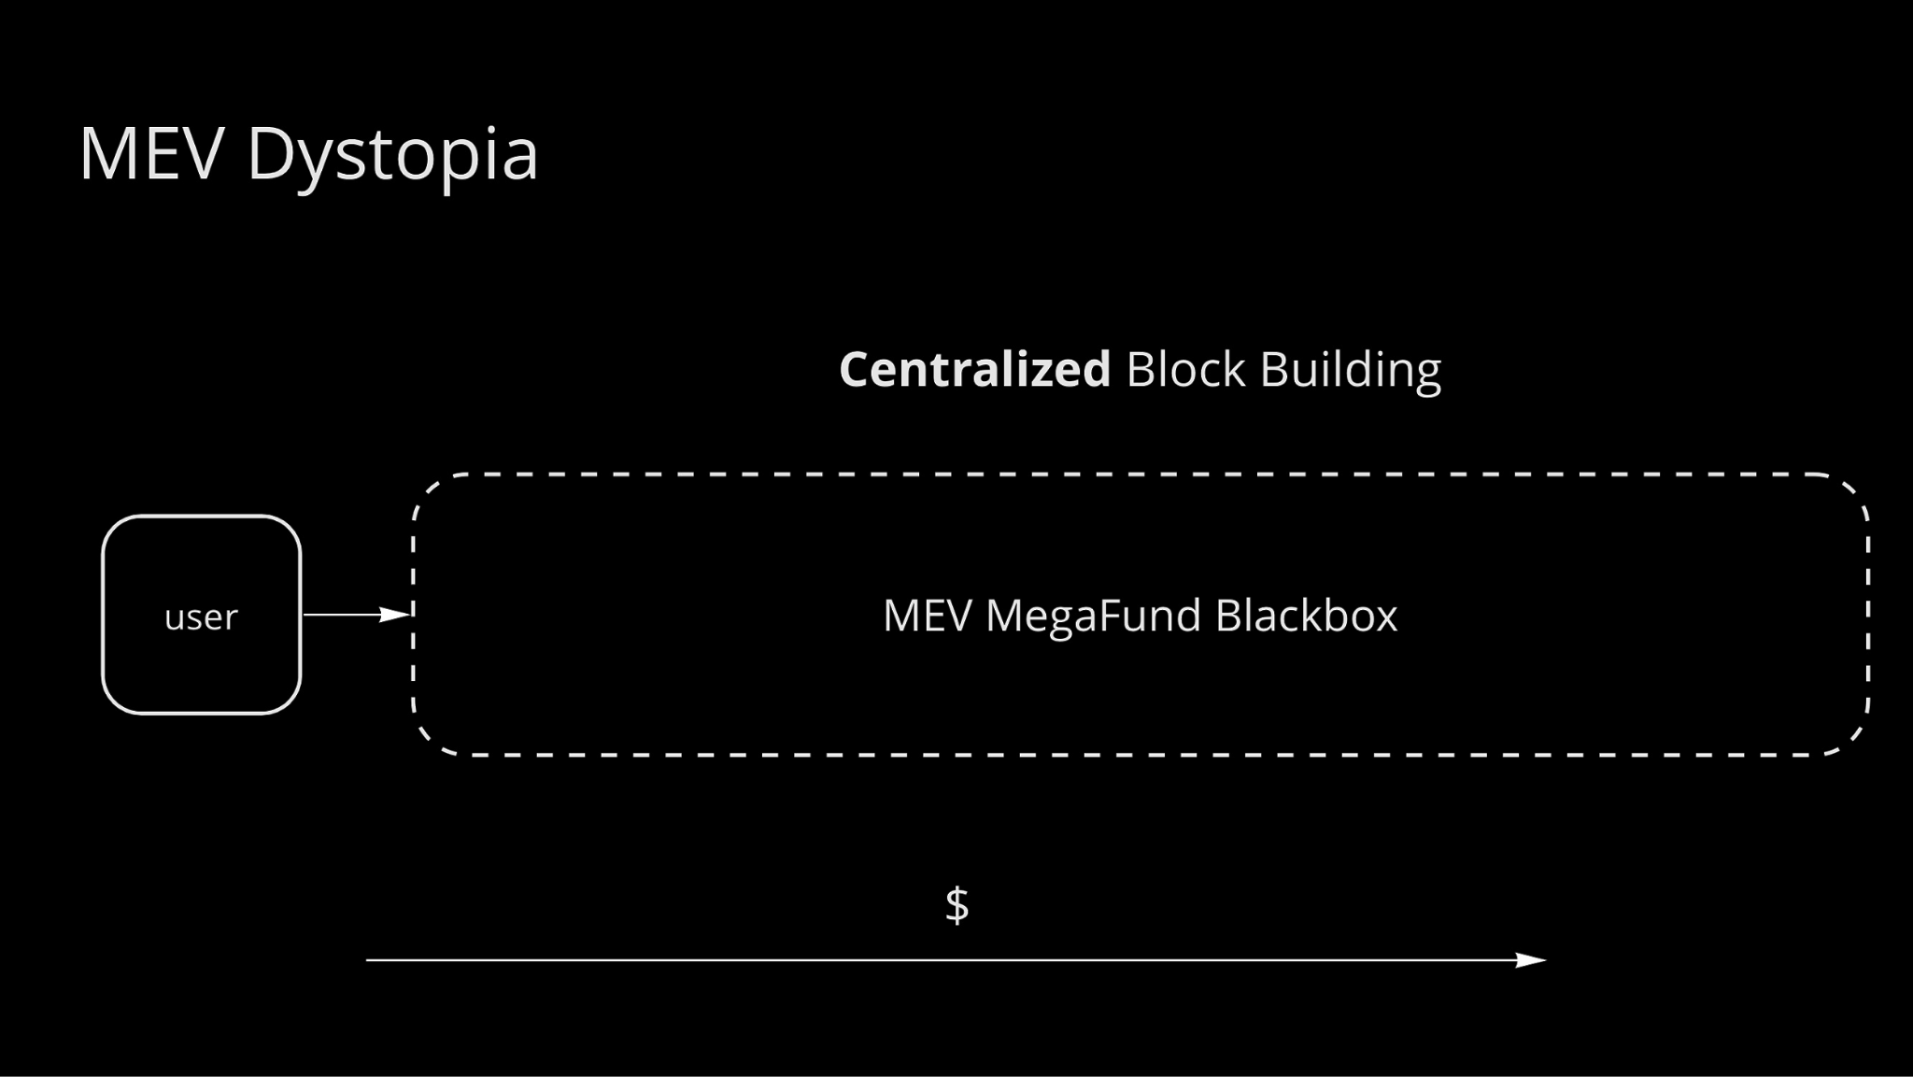

Slide 5
MEV Dystopia
Vertical integration → No competition between suppliers → worse guarantees for users:
Loss of censorship resistance
Monopoly can charge arbitrarily high fees to users
What are the paths from here to there? That is the topic of today‘s talk. We‘ll cover both scenarios where it has been avoided and where we need to avoid it in the future

Slide 6

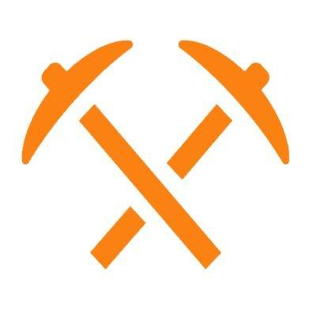

Slide 7
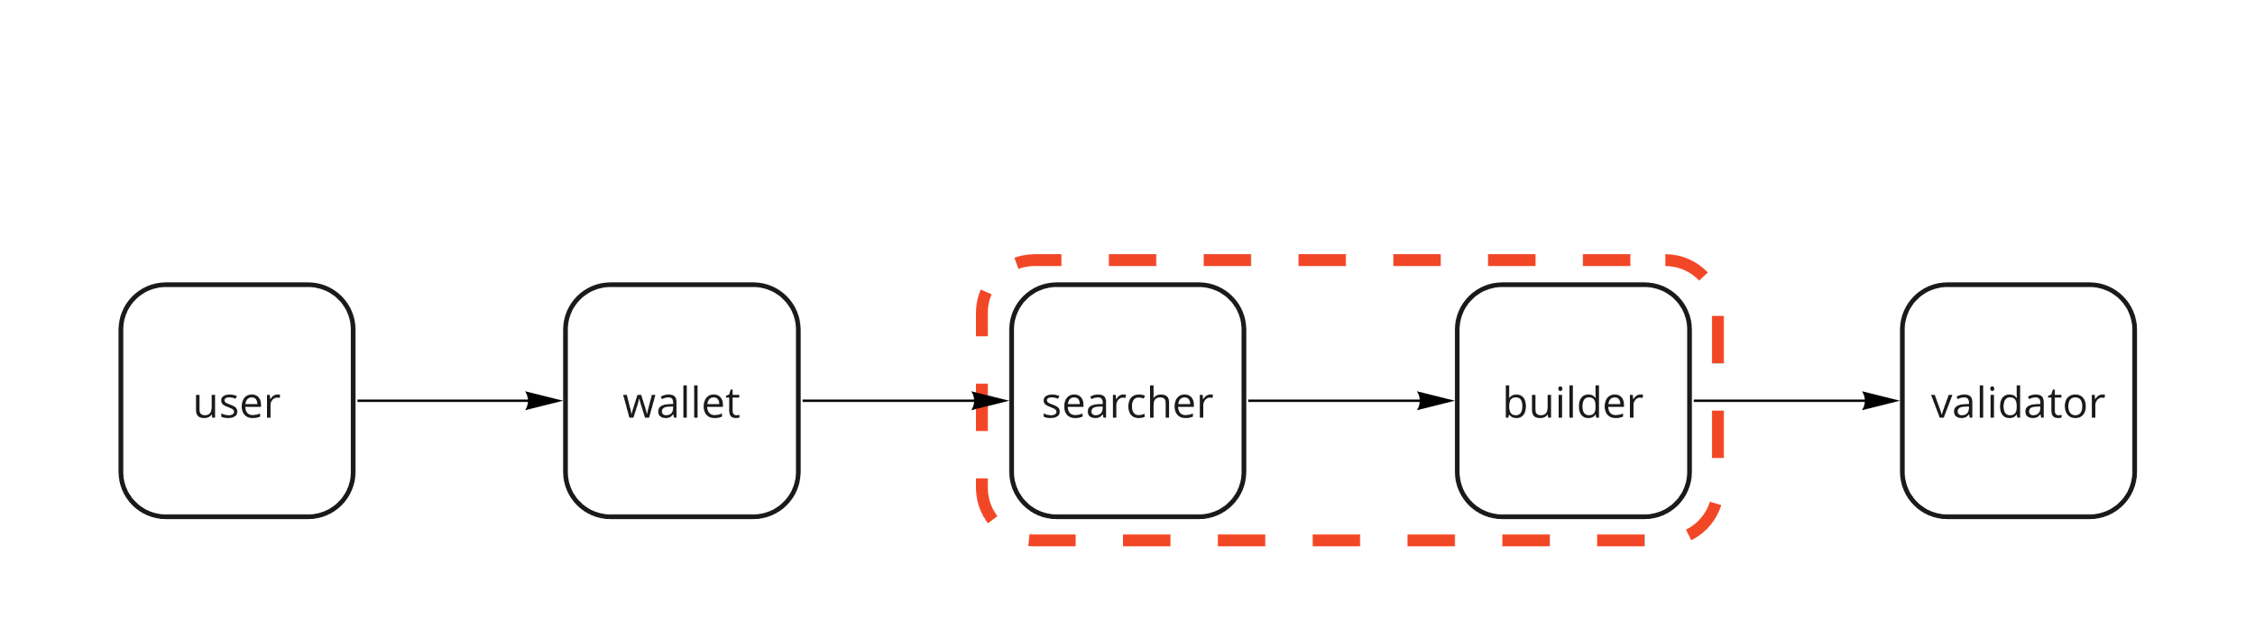
Challenge 1: MEV makes building hard

Slide 8
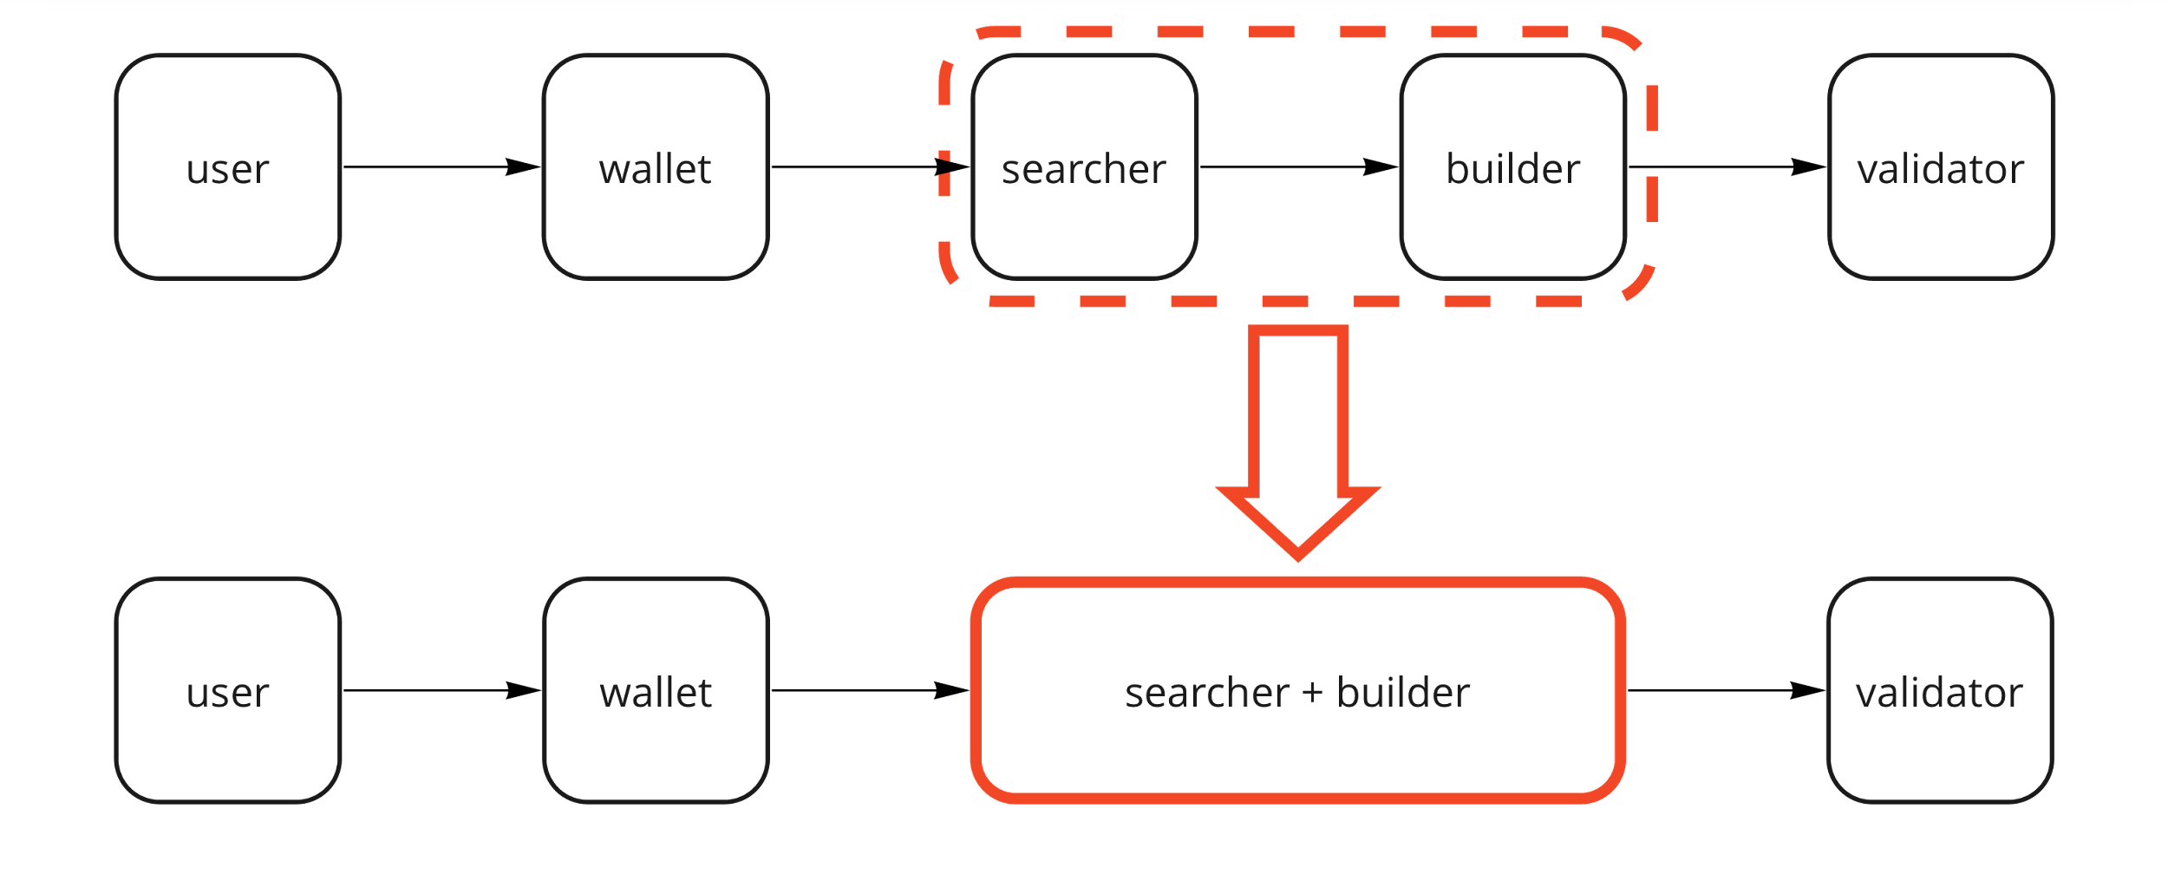

Slide 9
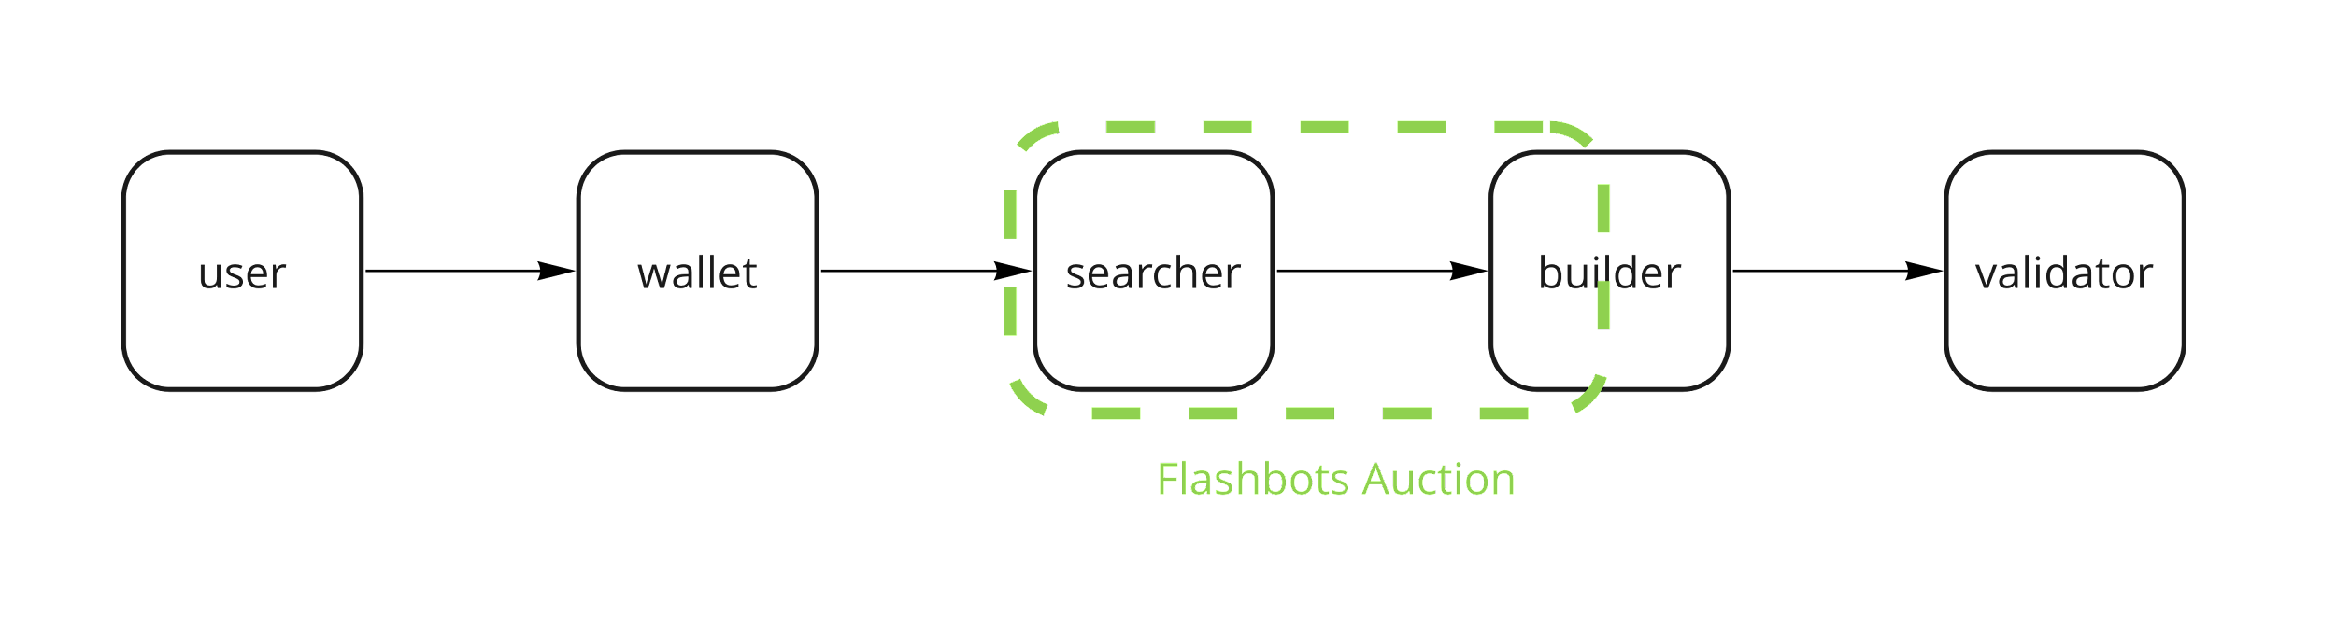
Response 1: Flashbots with MEV-Geth

Slide 10
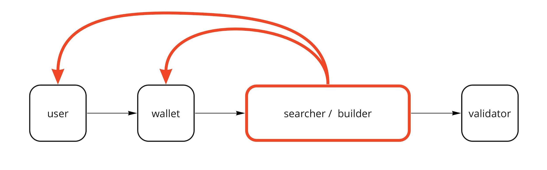
Challenge 2: Rise of exclusive orderflow

Slide 11
Response 2: A decentralized home for orderflow
Users and wallets will follow their short-term incentives
So other suppliers will have to start paying them
Conjecture: Flashbots is a vertically integrated block builder (searchers + miners) to generate to max MEV - BUT its open and permissionless
So is there a equivalence here for orderflow?
Can you create a decentralized solution that pays users more for their orderflow than any centralized one?

Slide 12
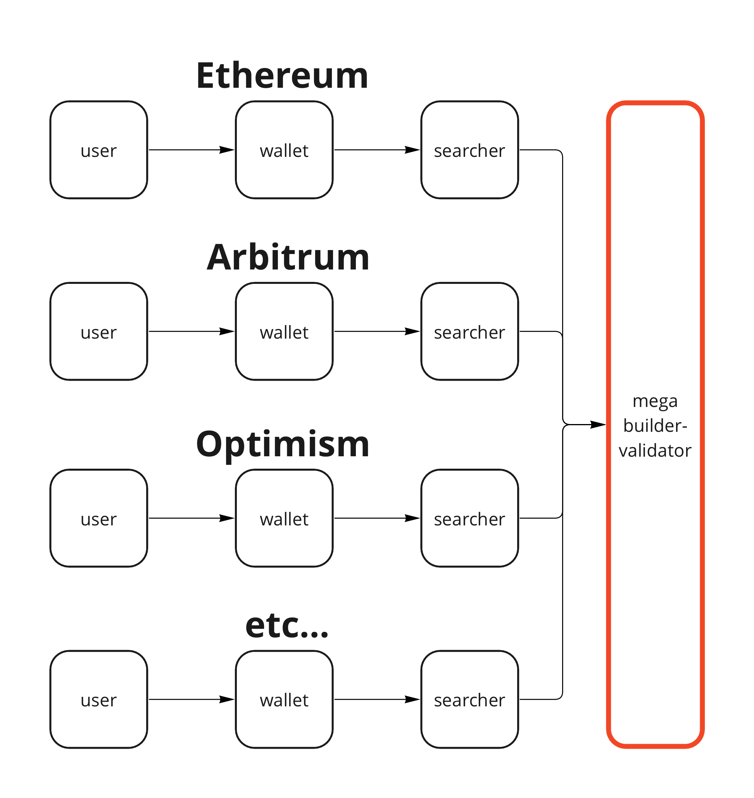
Challenge 3: Flashbots does not give exposure to cross-chain MEV

Slide 13
Solution 3: Flashbots-like market for cross-chain MEV
Allowing validator on different domains to cooperate with each other and with cross-chain searchers.
Again, strictly better than them forming a private cartel
Note that this issue affects the supply chains of all domains, not just Ethereum. You can run but you can‘t hide.

Slide 14
What do we want instead?
Super flat supply chain
Maximum competition at each layer
All orderflow is private but in open domain
Low barrier to entry → best guarantees for the user

Slide 15
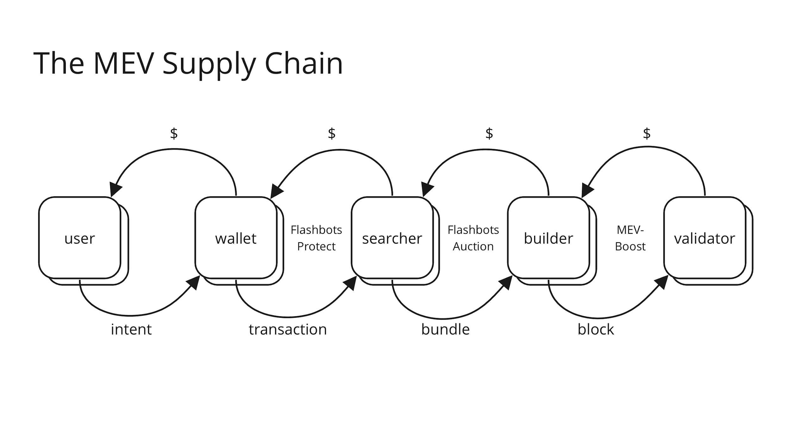

Slide 16
Takeaways
The biggest risk from MEV is that of vertical integration in the transaction supply chain
The supply chain meme is a useful mental model for understanding where incentives drive the risk of vertical integration
If we want to keep public blockchains decentralized and censorship resistant, we have to identify these paths ahead of time and take action to prevent them
Keeping the supply chain flat will come down to creating the APIs for trustless collaboration between the different suppliers: e.g. between searchers and builders, and builders and validators

Slide 17
Takeaways
A lot of power and responsibility will accumulate in the builder role → so that is where Flashbots will focus on. We want to create a decentralized block builder that can outcompete any centralized one and keeps public blockchains competitive and decentralized.

